Slide 1

FAKULTI BAHASA DAN LINGUISTIK
GBT 0002 : CRITICAL THINKING AND PROBLEM SOLVING SKILLS
PN SITI ROHANA BINTI MOHD THANI
srohana@um.edu.my
603-7967 3116

Slide 2
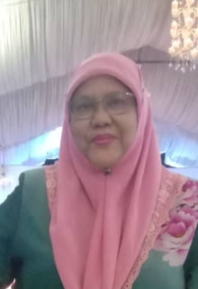
WEEK 6
Problem Solving and Decision Making Skills

Slide 3
Problem Solving and Decision Making
Week 6
Critical Thinking and Problem Solving Skills
By
Siti Rohana Binti Mohd Thani

Slide 4
Introduction
- Everybody’s got problems.
- The good news is that most problems can be
solved.
- We have to learn to confront and solve problems
effectively.

Slide 5
The Six Habits of Effective Problem Solvers
Admit you have a problem
-requires honesty and courage
2. Figure out exactly what the problem is
- identifies the problem
- analyses it systematically
3. Identify possible solutions
- any alternative

Slide 6
The Six Habits of Effective Problem Solvers
4. Evaluate the possible solutions
- finds pros and cons of each potential solution
5.Pick the best solution, commit yourself to it, and act
- works on only one resolution at a time
- avoids problem situations that can weaken willpower or
increase temptation
- cultivates good habits
- uses ‘bright lines’..to assist self-control
- relies on social support and public approval
- precommits to good behaviors in advance

Slide 7
The Six Habits of Effective Problem Solvers
6.Monitor how well the solution is working
- follow up…make sure the problem has been fixed
Good problem-solving skills help us navigate life successfully and steer us in the direction of our dream

Slide 8
Any Question?
Thank you

